Slide 1
Woodland Public Schools
Facilities and Safety Report
December 2019 & January 2020

Slide 2
FACILITIES REPORT
Reunification Drill (condensed version)
The reunification drill will be held Friday, March 6th from 9am to 12pm.
Drill will include support from Police, Paramedics, Fire and Cowlitz EOC.
The purpose of this drill is to:
Test the reunification system/bus plan at one of our largest schools.
Exercise the reunification process with parents, guardians, students and staff.
Test the reunification site procedures and equipment set up.
Drill with fire, police and ambulance to simulate an actual emergency.
Drill will kick off at WMS with a simulated gas leak and fire.
All students will evacuate to buses to test the emergency bus plan.
4 classrooms of students will reunify at WHS.
There will be numerous scenarios at each campus (WMS/WHS).
Drill will end at 11AM followed by a debrief and critique.
WMS students will be given lunch at WHS, then returned to WMS to reunite with their classes.

Slide 3
FACILITIES REPORT
Urgent Repair Grant Program - The District was awarded just under $39k from the OSPI Urgent Repair Grant Program. These dollars were requested to replace the section of piping from Park Street to the buildings on the north side of the Middle School campus. This pipeline appears to be original to the schools auditorium, gym and CTE buildings. Our department will also be doing some of the piping work to maximize these grant dollars and the benefit.
Summer Planning
Hard to believe summer is just around the corner. We have started the summer maintenance planning list. A few major projects for the summer include roof work at WMS and WPS, exterior painting of the Green and Yellow Halls (inner school sections), exterior lighting upgrades, electrical panel upgrades at WMS, and some exterior work involving gutter replacement and masonry work at WMS.
Solar
Mechanical permits are issued. We will wait until spring to foundation footings. Once in, we can start building the frame for the system and move forward on the assembly.

Slide 4
FACILITIES REPORT
Earthquake Survey Woodland School District is participating in the Washington State School Seismic Safety Project (SSSP). This program is led by the Department of Natural Resources’ (DNR) Washington Geological Survey (WGS). This is a statewide project to evaluate how Washington public school buildings could be affected by earthquake shaking. The best part is this project is funded by the Washington State Legislature. Schools participating in the program include WMS, CES and the Yale School. We are in the preliminary steps of this study and have sent DNR electronic copies of our school drawings. DNR completed Phase 1 of this project last year for 222 school buildings throughout Washington State. The assessment consists of two parts: (1) a seismic site class evaluation of soil conditions, and (2) detailed inspections of the exterior and interior of the buildings by a licensed structural engineer.
Unpleasant Odor WHS We have been struggling to find the source of a foul odor at WHS in the main hallway north end. The odor would come and go at random intervals, which made troubleshooting the problem very difficult. We were finally able to track it down to a sink in a small room not normally occupied (Green Room). As the room became negative in pressure (HVAC control), the sewer gas would exit the sink drain and go through the air, return back to the air handler and discharge to the hallway. Normally, a running air compressor kept this trap full; but around 1 year ago the compressor was shut off, which was the source of the problem causing the sink trap to empty.

Slide 5
FACILITIES REPORT
Security Cameras A review of all security cameras at WHS have identified that a large percentage of the cameras have some level of maintenance required. This includes focusing issues and aiming of the cameras. Some of the cameras have a yellow hue that may be associated with imminent failure. We will contact the OEM to see what our options are for these issues, and add this work to our Spring Break and summer work list.
Annual Compliance Reports Completed annual compliance reports for the Southwest Clean Air Agency, Department of Health and the City of Woodland. This included annual backflow device checks, draining and winterizing exterior fire systems, annual emissions (stack testing), boiler inspections and the Yale septic operations and maintenance report.

Slide 6
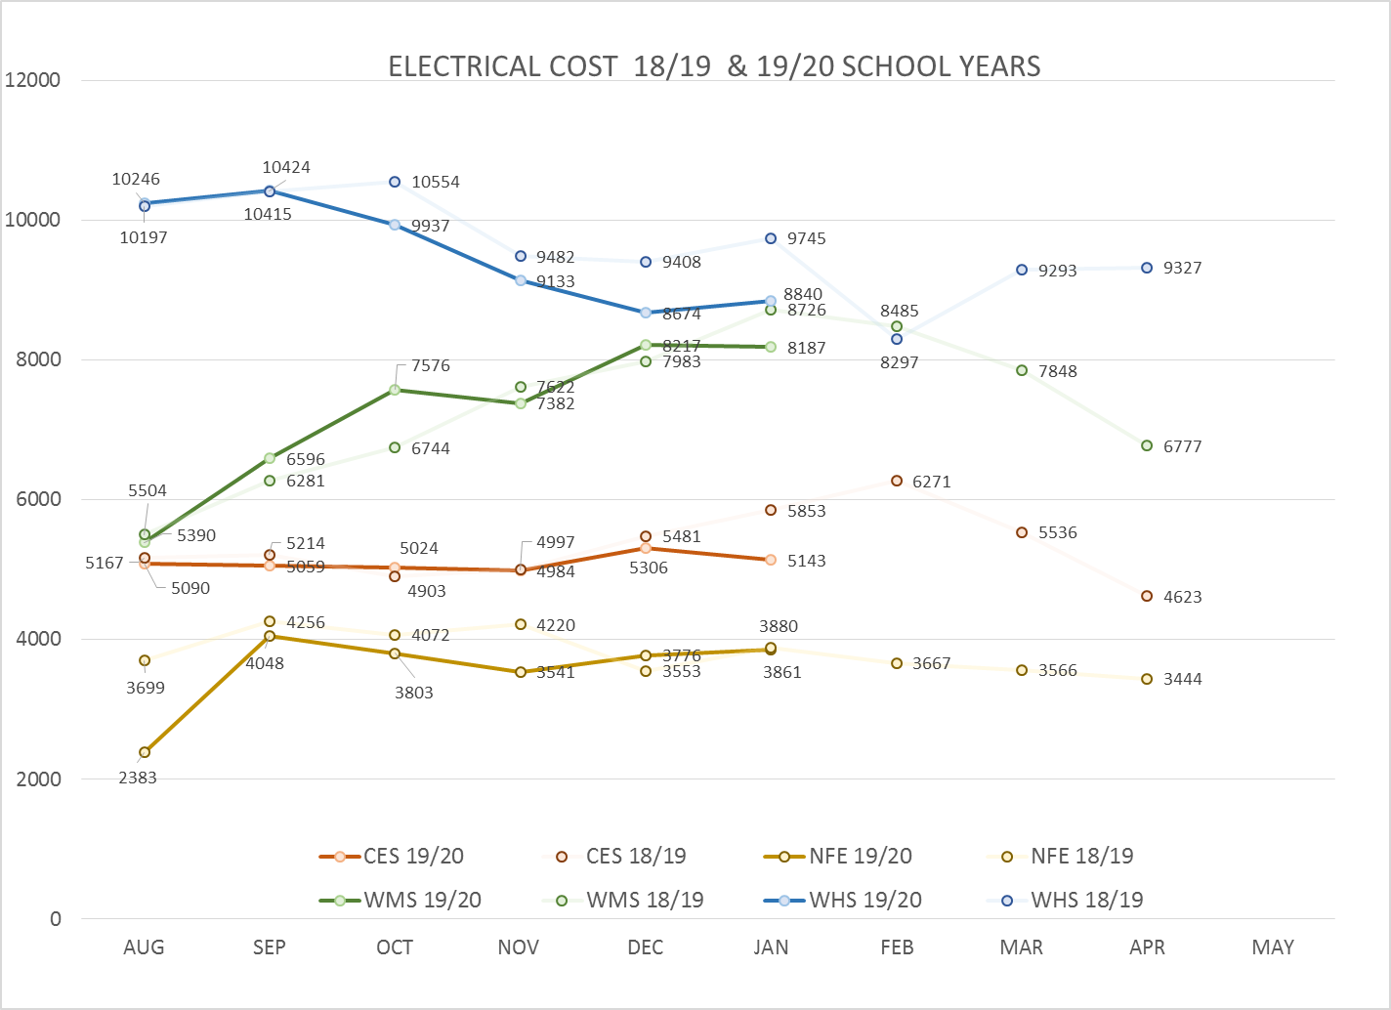
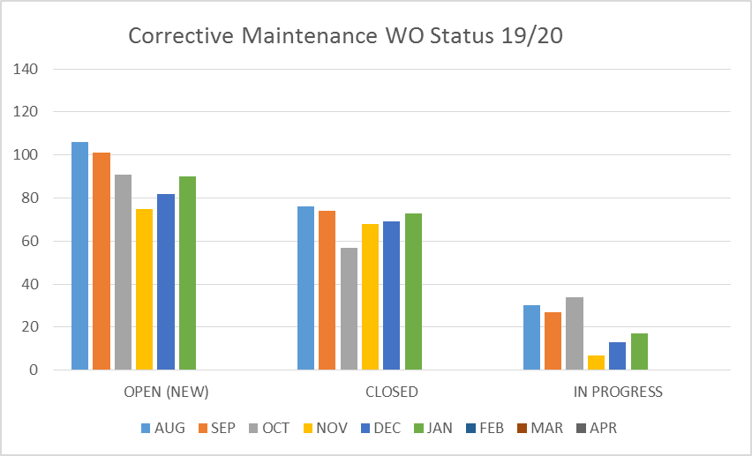
FACILITY CHARTS – POWER COST AND WORK ORDER STATUS

Slide 7
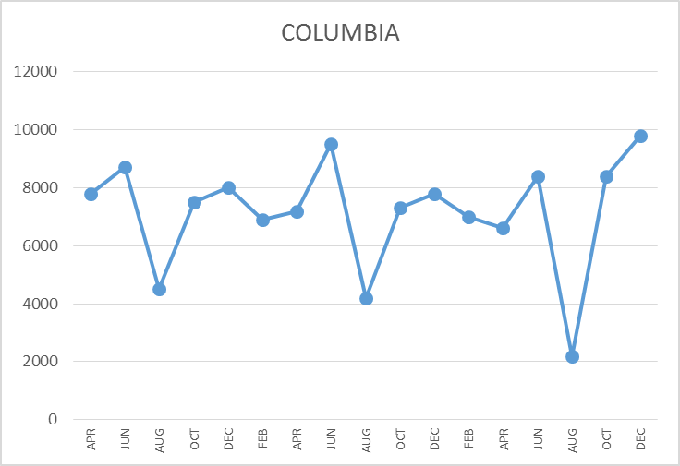
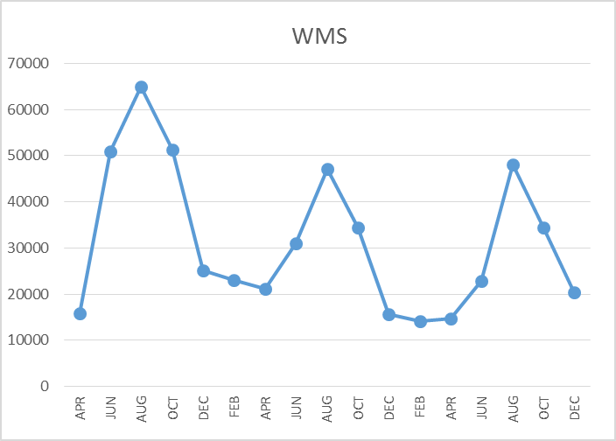
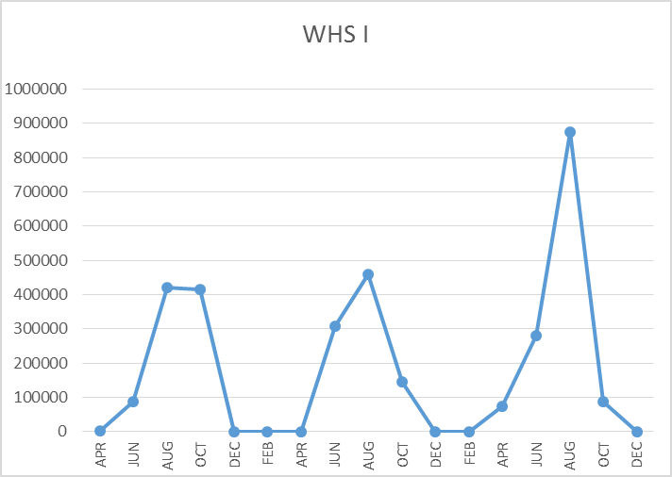
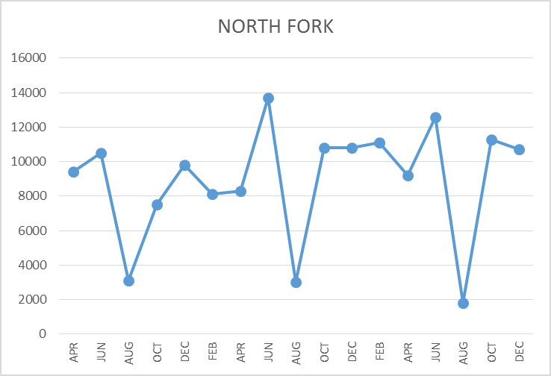
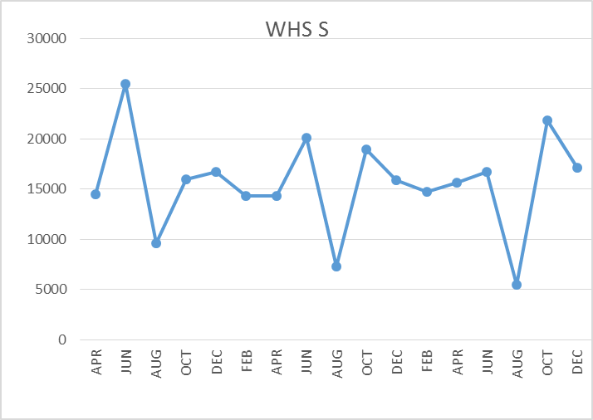
FACILITY CHARTS – WATER USAGE WHS, NFE, WMS, CES
Note
Water charts are updated every two
months. Next update to these charts in March 2020
The WMS chart has been reconfigured to include the following 7 meters: 755 Park high and low flow, BO and Team High, PIT house, bus barn, athletic field and DO. All of these meters are totaled on the WMS graph, but each data point is recorded separately to aid in identifying leaks.

Slide 8
Safety Summary (December and January)
Staff Accidents/Incidents (13)
CES-Employee strained back when throwing garbage bag in dumpster
NFE-Student bent employees finger backwards when trying to de-escalate
WMS-Employee strained left side while positioning herself to protect student from injury
WMS-Employee suffered mental and physical stress when trying to calm student
WHS- Employee twisted knee while walking down stairs
CES-Student threw block at employees head, cut/laceration
Yale-Employee slipped in slush, strained back
WMS-Employee slipped in apple sauce, strained knee
CES-Student threw train engine striking employee in head, no injury reported
CES-Student bent employees finger backwards, sprained finger
CES-Student hit and kicked employee during de-escalation
NFE–Student stabbed employee with pencil, laceration
CES– Student pulled hair of employee causing neck injury
Student Accidents/Injuries (7)
WHS-Student suffered concussion when ball hit her head, kick by another student
WMS-Student rolled ankle while playing basketball, bruise
WMS-Student was hit in head and left side of face during fight
WMS-Student dropped weight on foot, bruise
WHS-Student tripped and broke two front teeth
WMS-During wrestling, student hit head on mat, concussion
WHS-Student was tripped during lay up and hit the floor with her head

Slide 9
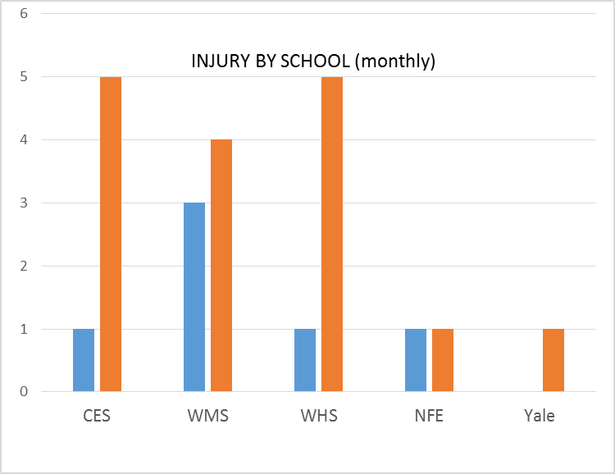
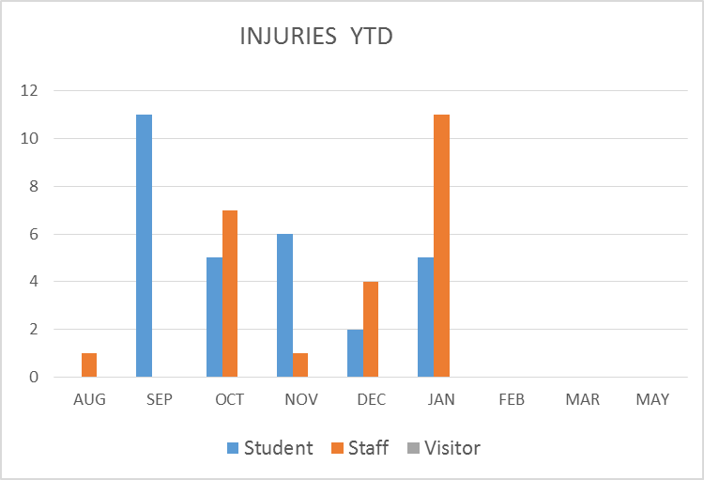
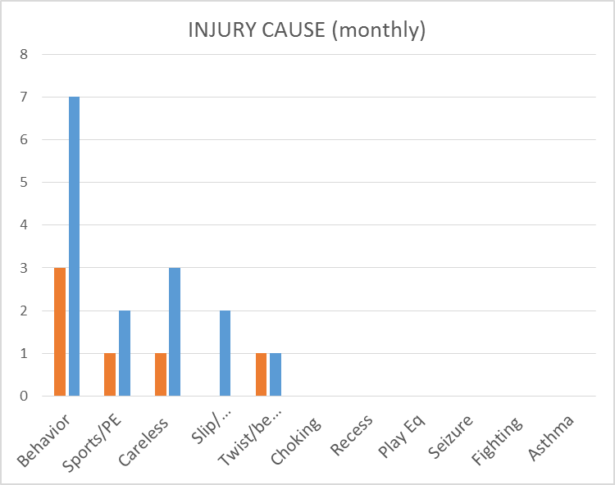
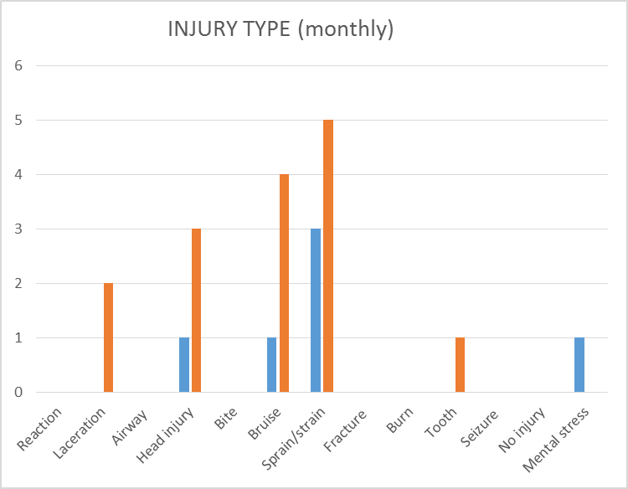
SAFETY CHARTS

